Slide 1
Gold Project
Intraday Decision Support System for XAU/USD
Machine learning MVP using technical and macroeconomic variables.
Franklin Patricio
University of Chile

Slide 2
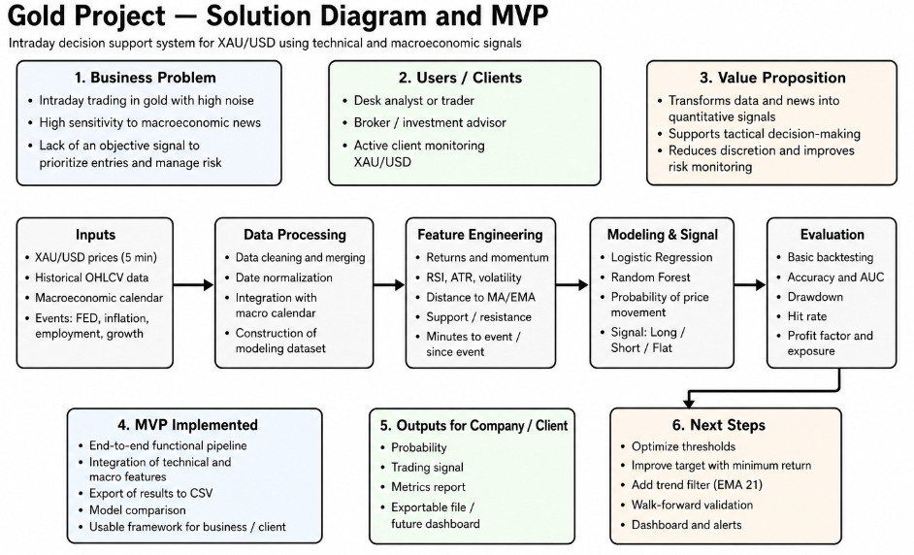

Slide 3
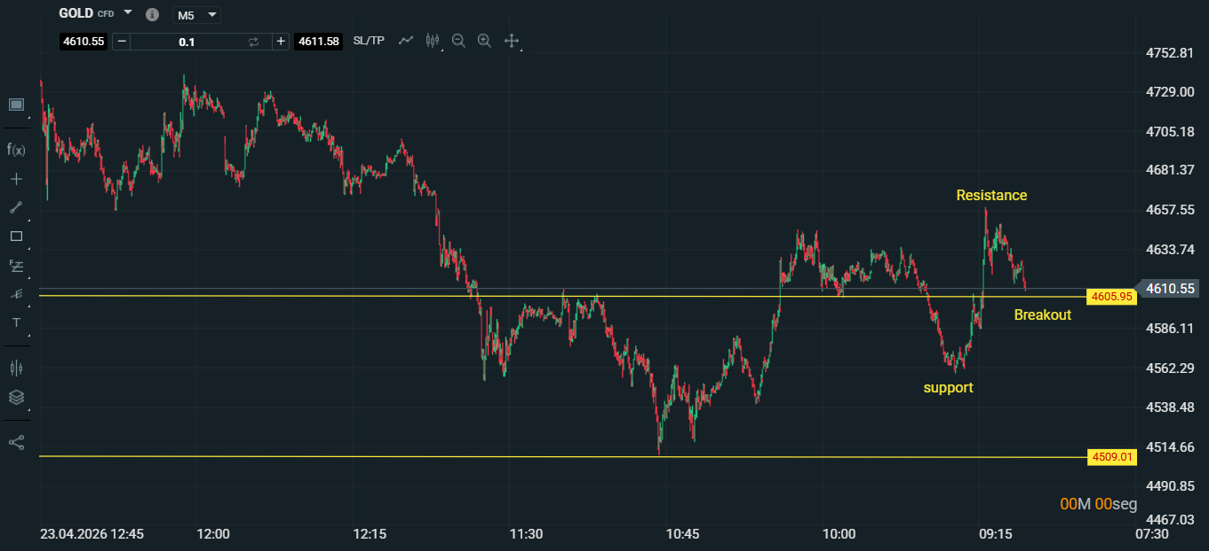

Slide 4
Solution Overview
Quantitative trading model integrating technical indicators and macroeconomic data.
Generates trading signals based on ML models.

Slide 5
MVP Implementation
• 5-min OHLCV data
• Macro calendar integration
• Feature engineering (RSI, ATR, volatility)
• Models: Logistic Regression & Random Forest
• Signal generation and backtesting

Slide 6
Key Results
• 12,741 observations, 43 features
• Logistic Regression outperformed Random Forest
• Accuracy ~0.52, AUC ~0.53
• Reduced losses vs benchmark
• Not yet consistently profitable

Slide 7
Conclusions
• Feasible quantitative trading system
• End-to-end pipeline built
• Strong base for future improvements
Next steps: optimization, validation, more data

